Slide 2
Communication entities: Data, Signals, Transmission and Channel
Data is the entity that is to be exchanged between different computers(voice, number, image..)
Signals electrical or electromagnetic representation of data
Data transmission is communication of data by the transmission or propagation of electromagnetic signals through either wired/wireless media (channel)

Slide 3
Analog vs. Digital signal
Analog signal
Continuous signal
Uses continuous range of values to represent information
denoted by sine waves
Analog technology records waveforms as they are
Sine waves
Digital signals
discrete time signals
denoted by square waves
Uses discrete or discontinuous values to represent information
Samples analog waveforms into a limited set of numbers and records them
Square waves

Slide 4
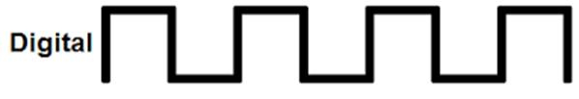

Analog vs. Digital Representation
Analog Signal
Digital Signal

Slide 5
Electro magnetic waves
Electrons when propagated either in a guided media or free space follow a wave like pattern
They have both an electrical as well as a magnetic field associated with them
Hence the waves are electro magnetic waves
All of these waves vary with time in direction and intensity.
They move with speed of light in vaccum; Speed decreases after entering materials
They move through vacuum, and do not need a medium to travel

Slide 6
Examples in day to day life
Light
Voice
Radio waves…..

Slide 7
Representation of E.M. wave
Function of Time
Function of Frequency
AMPLITUDE
AMPLITUDE
TIME
FREQUENCY

Slide 8
Attributes of an E.M. wave
Amplitude
Frequency
Wavelength
Phase

Slide 9
Periodic vs. Aperiodic waves
AMPLITUDE
AMPLITUDE
TIME
TIME
Periodic wave: Repeats itself over time
(Sine wave )
Aperiodic wave: Does not repeats itself over time

Slide 10
Mathematical representation
S(t)= A sin (2 Л f t + Ф)
A = Amplitude; f = Frequency; t = Period;Ф = Phase
A
AMPLITUDE
TIME
t

Slide 11
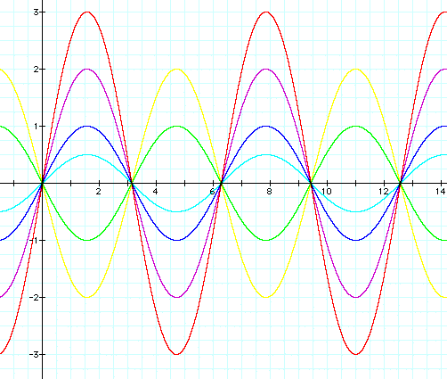
Parameters : Amplitude
Amplitude: Maximum value or strength of the signal over time. Unit is volts
A = 1
A = 2
A = 3
A = -1
A = 0.5
A = -2

Slide 12
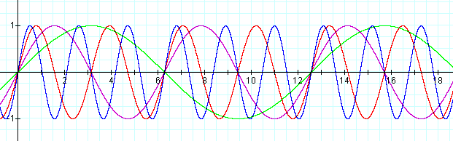
Frequency
Frequency(ν): Number of cycles per unit time. Unit is hertz
Time period(T) : Amount of time taken to complete one cycle. Unit is sec, ms…etc.
T = 1/f
f = 3; t = 1/3 sec.
f = 1 ; t = 1 sec
f = 2 ; t = 1/2 sec
f = 0.5 ; t = 2sec

Slide 13
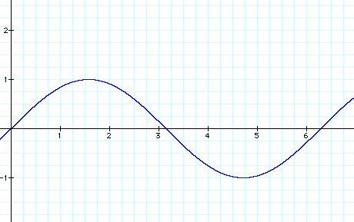
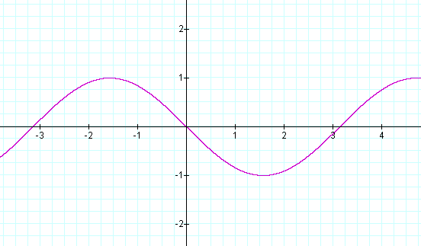
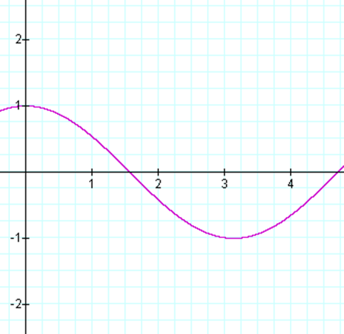
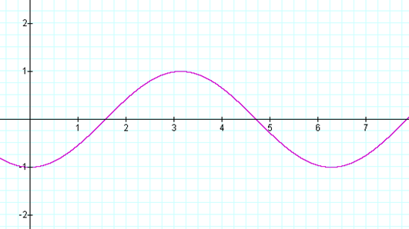
Phase shift
Phase shift : 0
Phase shift : 180
Phase Shift
Shift from the origin Unit is degrees or radians
A negative phase shift indicates a movement to the right, and a positive phase shift indicates movement to the left.
Phase shift : 90
Phase shift : -90

Slide 14
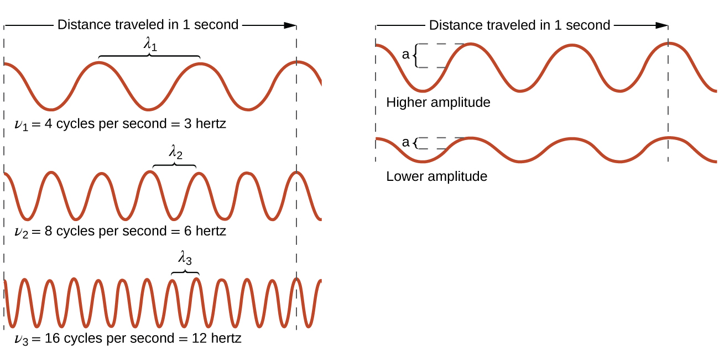
Wave length
Wave Length
Distance covered by one cycle. Distance between two peak values of a wave
Represented by symbol λ
Unit is unit of distance
As frequency increases, wavelength decreases
ν α 1/ λ or ν λ = c; where c is speed of light

Slide 15
Communication entities: Data, Signals, Transmission and Channel
Data is the entity that is to be exchanged between different computers(voice, number, image..)
Signals electrical or electromagnetic representation of data
Data transmission is communication of data by the transmission or propagation of electromagnetic signals through either wired/wireless media (channel)

Slide 16
Frequency
Spectrum: Range of frequencies comprising a signal
Bandwidth: Width of Spectrum
f = 3; t = 1/3 sec.
f = 1 ; t = 1 sec
f = 2 ; t = 1/2 sec
f = 0.5 ; t = 2sec

Slide 17
Frequency perspective or Time perspective for communication
Radio channels, satellite TV channels, mobile communication signals, Wireless LAN signals all coexist together in the free space medium without interference!!.
HOW???
They Operate on different range of frequencies

Slide 18
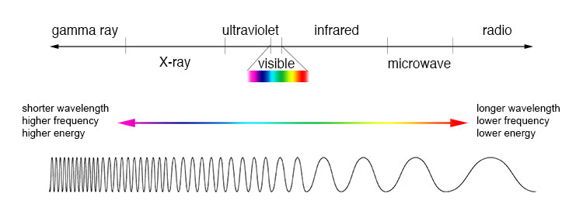
Electro magnetic spectrum
The electromagnetic spectrum is the range of all possible frequencies of electromagnetic radiation

Slide 19
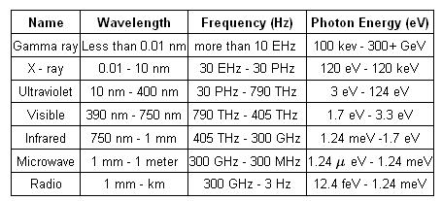

Slide 20
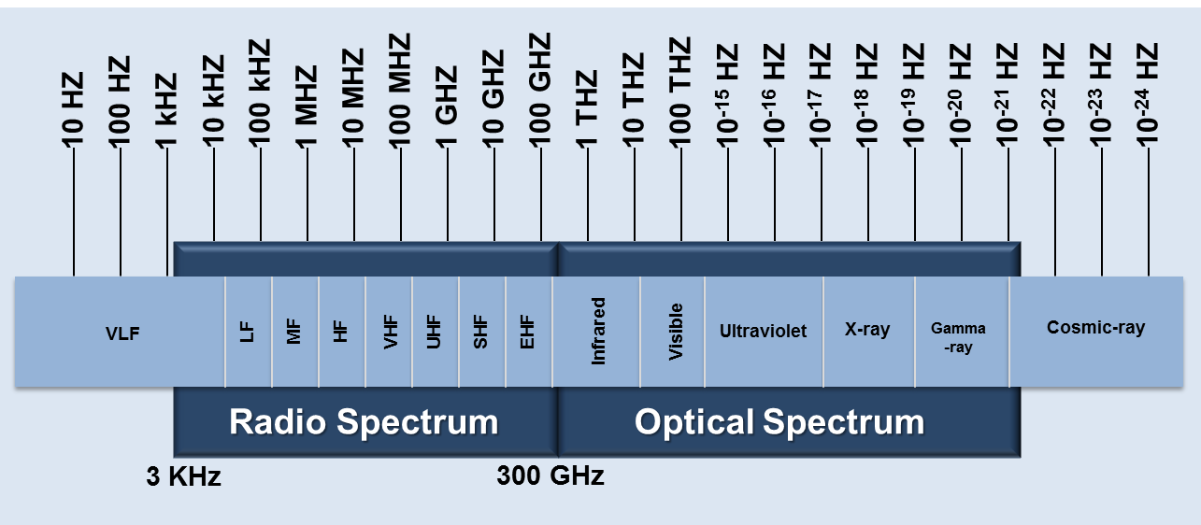
Bands suitable for communication
Radio Waves
Micro waves
Infra red waves
Visible spectrum

Slide 21
Radio Waves

Slide 22
Micro Waves

Slide 23
Infra red waves

Slide 24
Visible

Slide 25
Frequencies for common wireless transmission

Slide 27
Analog vs Digital signal

Slide 28
Analog vs. Digital Signal

